Slide 1
Available knowledge literature search
Christopher I. Macintosh, PhD, RN
Notes:
Hello everyone
My name is Chris Macintosh. I help teach the capstone courses.
Today we’re talking about finding literature related to the problem.
[Next slide]

Slide 2
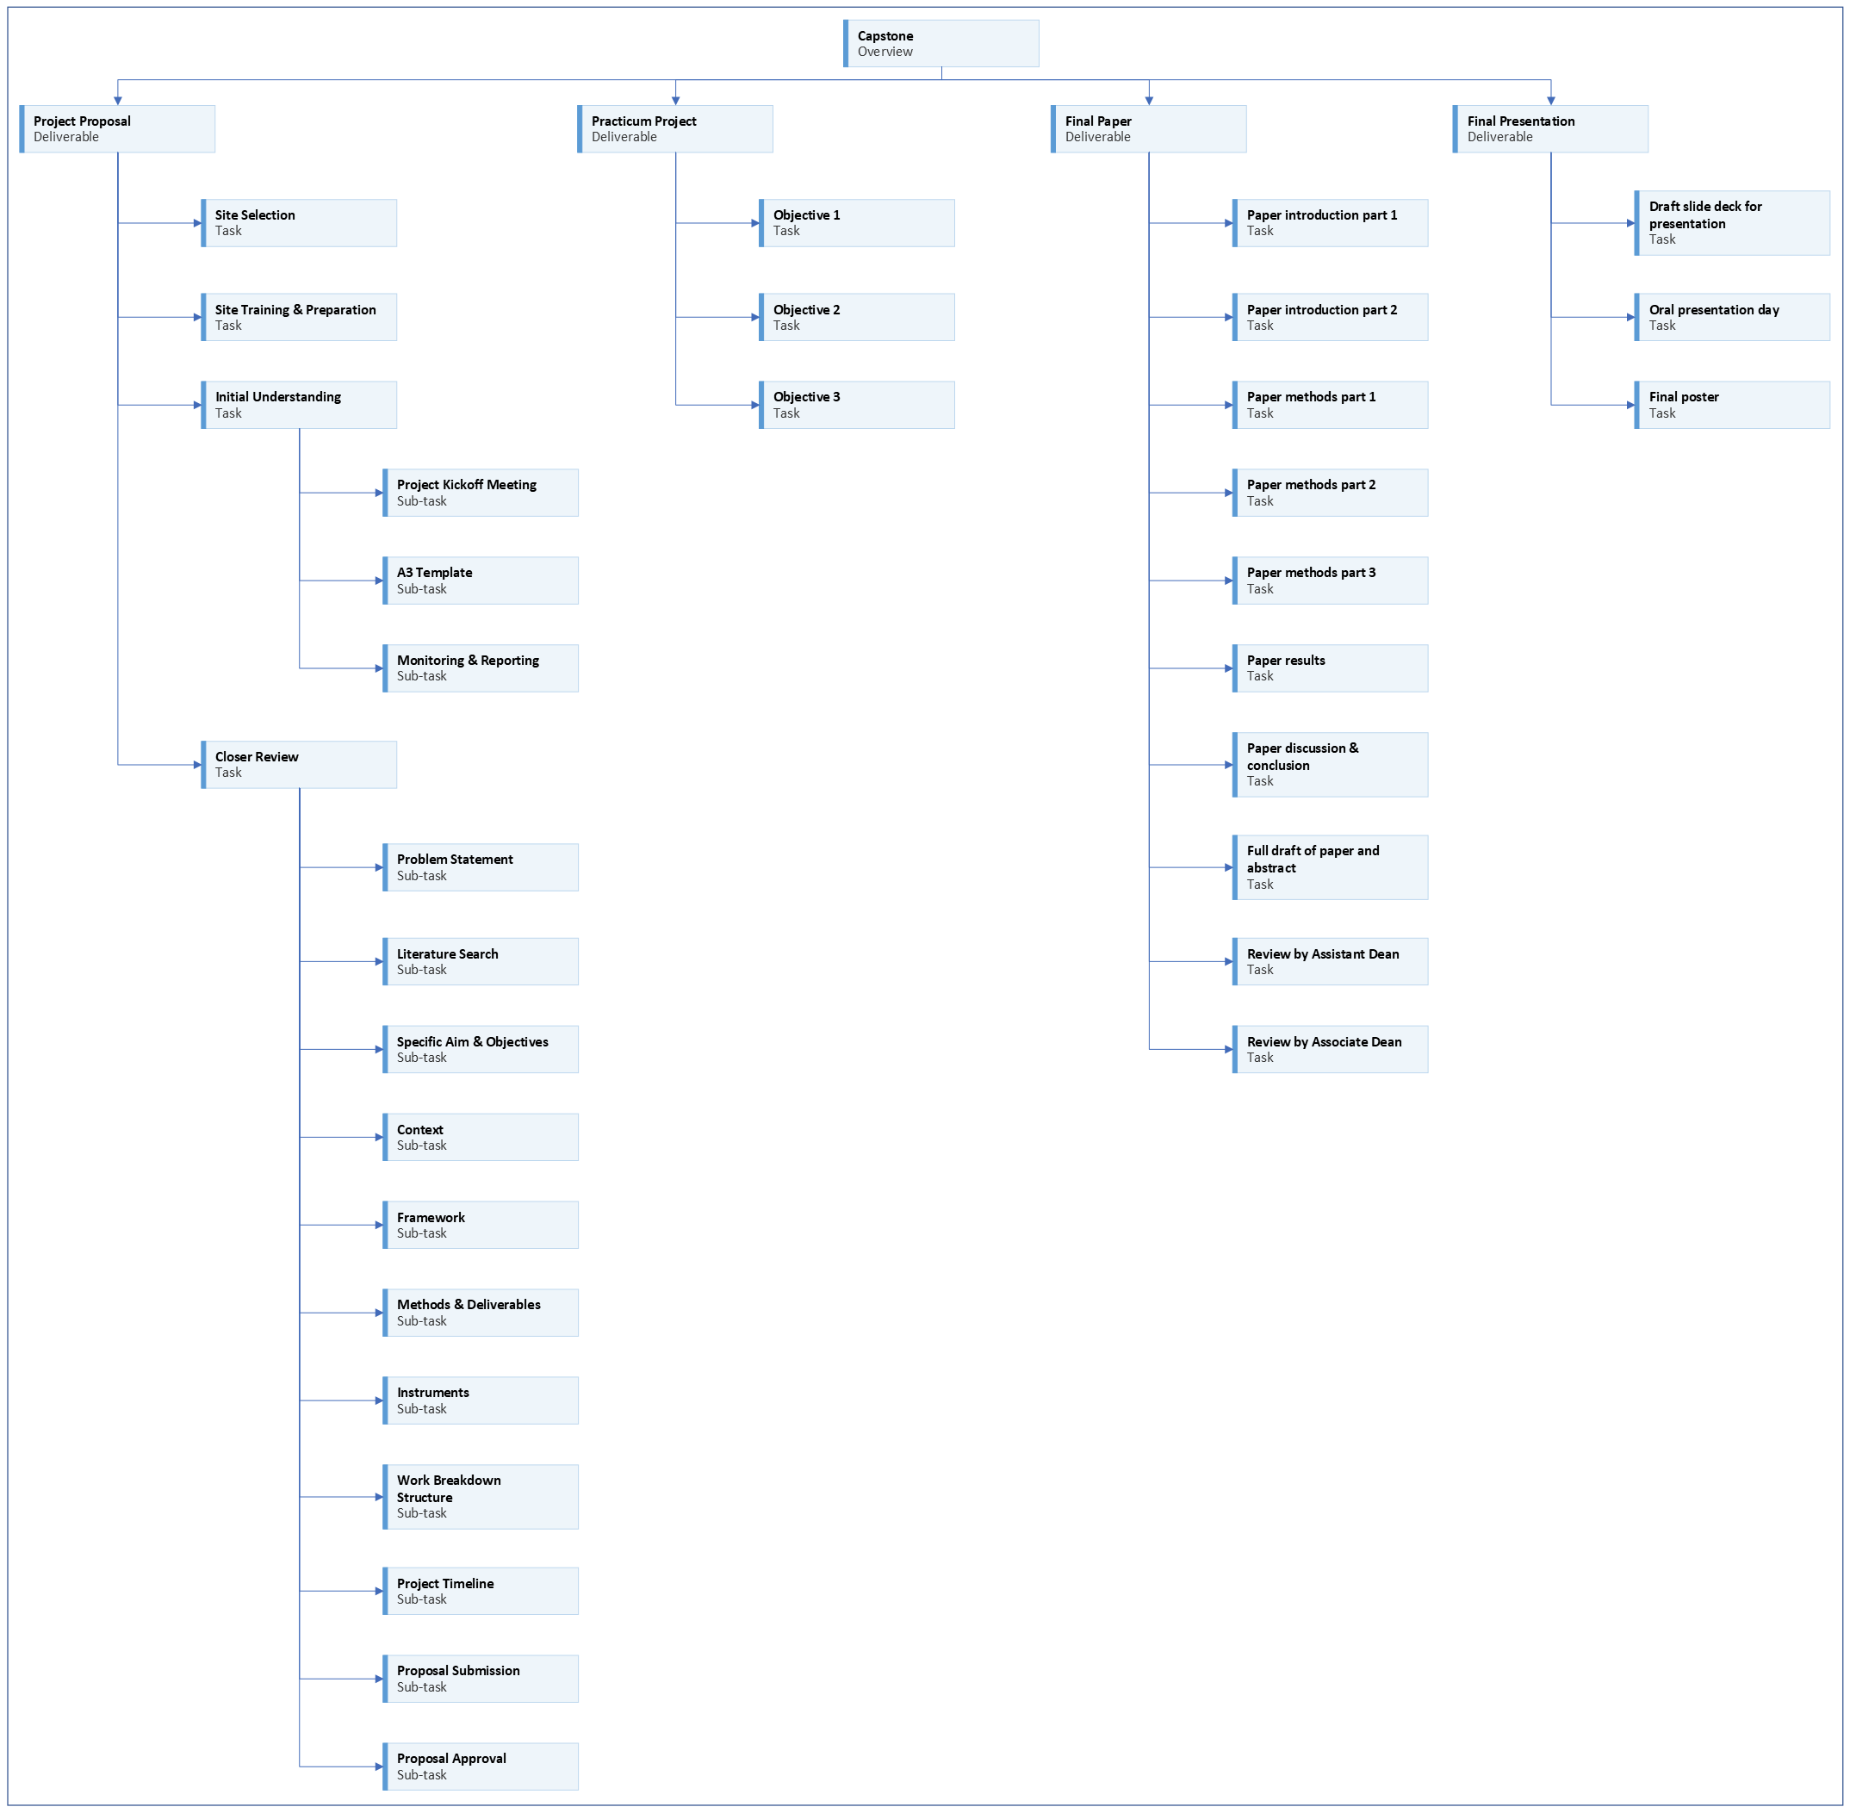
Notes:
We are working on the project proposal portion of your capstone experience.
[Next slide]

Slide 3
Notes:
Last time we talked about how to write your problem statement.
[Next slide]

Slide 4
Notes:
In this video we’ll talk about how to find relevant literature.
[Next slide]

Slide 5









Potential elements
Notes:
Last time we looked at some things to think about when developing a problem statement about the local problem.
Now it’s time to think and write about the problem in more general terms.
[click]
Is this a problem in other places, or have projects like yours been done in other places?
[click]
How are concepts related to your problem defined in the scholarly literature?
[click]
Who is affected by this problem more broadly? What people and systems?
[click]
When is it a problem?
[click]
Have any trends or patterns been identified?
[click]
Why does it matter?
[click]
Is there an existing standard or protocol that is not being met or followed?
What is the standard, how is it defined, and who publishes and maintains the standard?
[click]
How does it affect the patients or systems?
[click]
What will happen if this problem is not addressed?
Information in this section should expand on what is written in the Problem Description section and be supported by evidence.
You should use proper APA citations and references, so you need to keep track of the literature you find.
[next slide]

Slide 6
Searching for literature
Traditional sources
PubMed https://pubmed.ncbi.nlm.nih.gov/
Google Scholar https://scholar.google.com/
Eccles Health Sciences Library https://library.med.utah.edu/index.php
AI-powered options
Semantic Scholar https://www.semanticscholar.org/
Elicit https://elicit.org/
ResearchRabbit https://www.researchrabbit.ai/
Regular Search
Google https://www.google.com/
Bing https://www.bing.com/
Notes:
There are more resources for searching for scholarly and other literature available than ever before.
This list is not comprehensive.
(In fact, it may be out of date as I create these slides. Things seem to be changing so quickly.)
Since this presentation is focused on a capstone project and manuscript for a Master’s degree,
I would prioritize scholarly sources over popular literature.
I’ll divide these into more traditional resources and AI-powered resources.
[click]
Traditional sources include PubMed, Google Scholar, and scholarly databases available at Eccles Health Sciences Library.
[click]
Some artificial intelligence (AI) powered options include Semantic Scholar, Elicit, and ResearchRabbit.
I’m not going to give a tutorial on how to use each of these resources here.
Links to some additional information will be available on Canvas.
You can Google for resources about how to use those new tools.
[click]
That reminds me that regular search engines like Google and Bing can help you find relevant literature.
But I would prioritize scholarly sources over popular ones.
Bing is blurring the lines in this list. As of the time I created this presentation, Bing has added AI integration as well.

Slide 7





Taking notes
Notes:
Once you have an idea of what to search for and where to search,
You should be taking notes.
[click]
You should keep note of what databases you search and the search terms.
[click]
You should keep track of the articles or other literature you intend to read.
[click]
You should record the sections or passages relevant to your project and paper.
[click]
You should jot down ideas of what will be good to write.
[next slide]

Slide 8










the capstone toolkit
Notes:
[click]
The Capstone Toolkit includes a section for taking notes about your searches, literature, and writing ideas.
[Next slide]

Slide 9
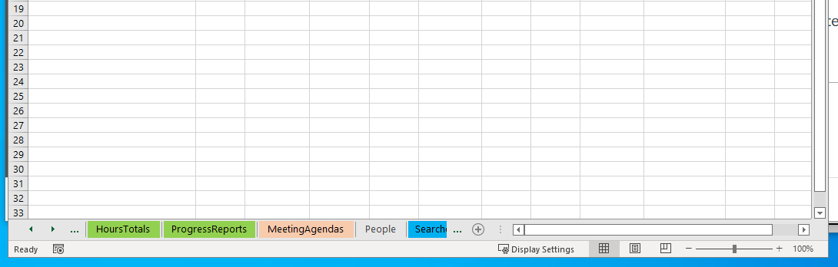
Notes:
[click]
The Capstone Toolkit is an Excel workbook that contains multiple sheets.
Tabs for sheets can be seen along the bottom of the window.
[click]
You can move the visible sheet tabs by clicking the left and right arrows in the bottom left corner of the window.
[click]
Look through the available sheet tabs until you find the desired sheet and click on the tab.
[next slide]

Slide 10

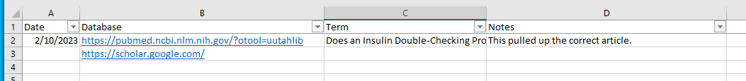
searches
Notes:
You can use any tool you like to keep notes.
I suggest being consistent in where you keep notes.
(Scattered notes are not very helpful when you can’t find something.)
Excel is an excellent option because it’s sortable, filterable, and searchable.
OneNote is another decent option because it’s also searchable.
I’ve included a worksheet in the Capstone Toolkit to keep track of searches you’ve conducted.
[next slide]

Slide 11

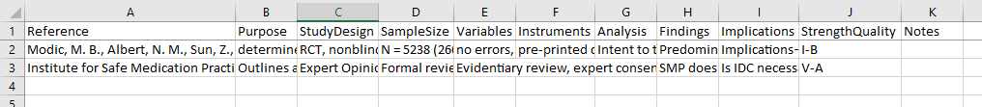
literature
Notes:
I’ve included a worksheet in the Capstone Toolkit to keep track of articles you find.
The headings at the top of the Literature sheet follow categories often important in evidence-based practice.
We are not quite as concerned with evaluating the strength of evidence as we are with completing the plan for our projects.
So it’s up to you how much you formally evaluate the strength of evidence for the articles you find.
[click]
But I STRONGLY recommend you pay special attention to the Reference column.
Take the time to find or create the proper APA reference when you first find an article you want to consider using in your proposal and paper.
Sometimes it’s really hard to find an article again if you didn’t keep good notes.
Don’t waste time recording articles in your list that don’t look promising.
I usually skim the abstract, and if that looks promising, I skim the paper.
If I don’t see something that catches my eye for what I need, I move on.
This process takes some practice.
Again, record the proper APA reference while you’re searching.
It will save you time in the long run. I promise.
If this page consists of nothing but APA references in the Reference column, that’s OK.
The main point is to start compiling the reference list.
[next slide]

Slide 12
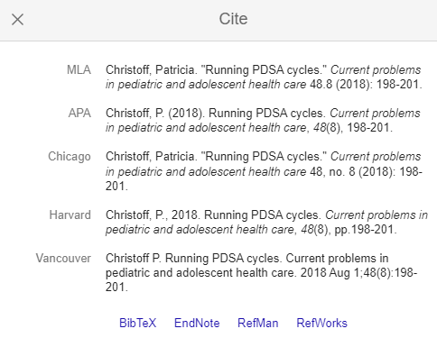
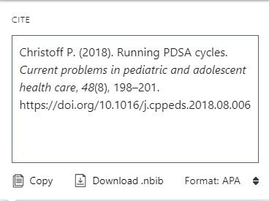

How to find the reference?
https://apastyle.apa.org/
Notes:
So how do you find the reference?
[click]
Clicking the Cite link in Google Scholar brings up citations and links to download for citation manager software.
Warning: Google Scholar citations do not always follow correct APA format. You need to double check them.
[click]
Finding the same article in PubMed and clicking the Cite link there is often the gold standard.
You’ll see the same reference in PubMed includes the digital object identifier (or DOI).
[click]
You can always create the reference yourself.
If you don’t have your APA 7 manual with you, you can look up a lot of examples on the APA style blog.
I know. I can hear the horrified gasps. But creating your own reference is not that hard once you’ve done a couple.
[next slide]

Slide 13

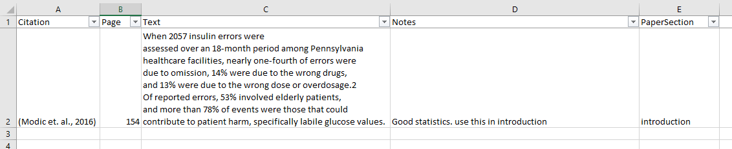
Writing notes
Notes:
The WritingNotes sheet is where the real magic happens.
[click]
When you find something in a literature source that looks relevant to your paper, I suggest you take note of it.
Add the citation in the citation column just like you would cite it in a paper. That will let you find the correct reference in the Literature sheet.
You will now have the correct reference and citation format for when you write your paper.
[click]
Record the page number of the information you think is relevant. It’s easier and faster to look it up again if needed.
[click]
Copy the short passage of text you think is relevant and paste it into the text column.
It’s nice to see what you thought was interesting without having to go look it up in the article again.
[click]
Record your thoughts in the Notes column.
If you’re going to paraphrase it in your proposal or paper, write the paraphrase right there.
Make yourself a note of why you thought this was interesting and how it might be used in your paper.
Here’s a Pro-tip. If you think of something that may be useful for your paper, even if it’s not related to this source, jot it down in the Notes section in a new row.
Keeping track of these thoughts when you have them will make writing easier later.
It’s easy to forget some good ideas if you don’t write them down.
[click]
Add what section you’re working on in the PaperSection column.
Hint: I’ve created the proposal sections to match the manuscript template sections.
When it comes time to write your paper, you’ll be able to sort these notes and group them into the appropriate sections quickly.
You don’t have to use this method. Feel free to invent your own.
This is just what I settled on after a lot of trial and error.
[next slide]

Slide 14



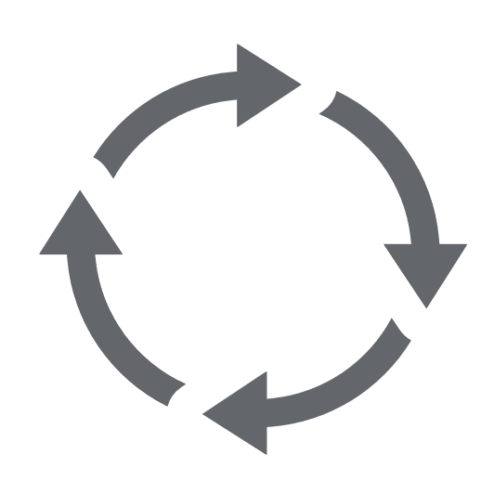
Assignment
Notes:
Your assignment is to write at least 1 paragraph regarding available knowledge about your problem.
You should cite at least two sources in this first assignment and include the references in the References section.
[click]
Information in this section should expand on what is written in the Problem Description section and be supported by evidence.
[click]
Use proper APA citations and references.
[click]
If you’re having trouble writing, just create bullet points that address the questions in the previous slide.
(Getting something down on paper is better than not writing anything.)
[click]
You will need to continue to add to the Available Knowledge section.
Eventually you should have 5-10 references in this section.
[next slide]

Slide 15




Writing tip
Notes:
I will reiterate the writing tips.
The Available Knowledge assignment will eventually become the Available Knowledge section of your project proposal and manuscript.
[click]
The more writing you can do this semester; the easier next semester will be.
[click]
Eventually I will be looking for well-formed paragraphs with topic sentences and supporting statements.
[click]
One way to check for well-formed paragraphs is try reverse outlining.
After you write your paragraph, highlight your topic sentence.
(I usually like to use light-gray to highlight topic sentences.)
Then check to see if the supporting statements in the paragraph support the topic sentence.
If they don’t all seem to support the topic sentence, then you need to write a broader topic sentence or split the paragraph into different paragraphs with separate topics.
[next slide]

Slide 16






Editing tip
https://github.com/cmcntsh/ReviewingWriting
(University of Utah College of Nursing, 2022)
Notes:
I will reiterate the editing tips.
[click]
I do recommend that students use Grammarly.
[click]
ChatGPT is a useful editing tool.
[click]
You can ask ChatGPT to improve individual sentences or paragraphs.
You can find additional information on my Reviewing Writing GitHub page.
[click]
It goes without saying that you alone are responsible for the content of your own paper.
Never use anything without reviewing it first.
There is a difference between getting help revising content you create and having another source create content for you.
[click]
Professional editing services can cost between $50 to $120 per hour on average.
It can save you time and money to use appropriate tools available to you.
[next slide]

Slide 17

More to come . . .
Notes:
That’s all we’ll do in this video.
There is more to come.
[next slide]

Slide 18
References
University of Utah College of Nursing. (2022). Master's of science nursing program policy and progression manual 2022-2023. University of Utah College of Nursing. https://nursing.utah.edu/documents/masters-policy-and-progression20222023final
Notes:
This was the only reference.

